Slide 1
OA3103: Data Analysis
Residual Diagnostics and R/Python Tools

Slide 2
References
ISLP/R: Chapter 3
Faraway: 2.3-2.11
Breusch Pagan Test, available https://www.statology.org/breusch-pagan-test/
"Multiple Regression in R, Step by Step," Josh Starmer, StatQuest. https://www.youtube.com/watch?v=mno47Jn4gaU

Slide 3

Theory $→$Application
Truth + Error Representation
Understanding of Linear Relationships (Coefficients)
Transformations (So far)
Look at Residuals to assess our model

Slide 4
Why we look at residuals at all
Residuals are the model’s “error report.”
If the model is appropriate, residuals should look like:
mean zero
roughly normal (for inference)
constant variance (aka homoskedasticity)
These checks tell us whether the linear model structure is appropriate.

Slide 5
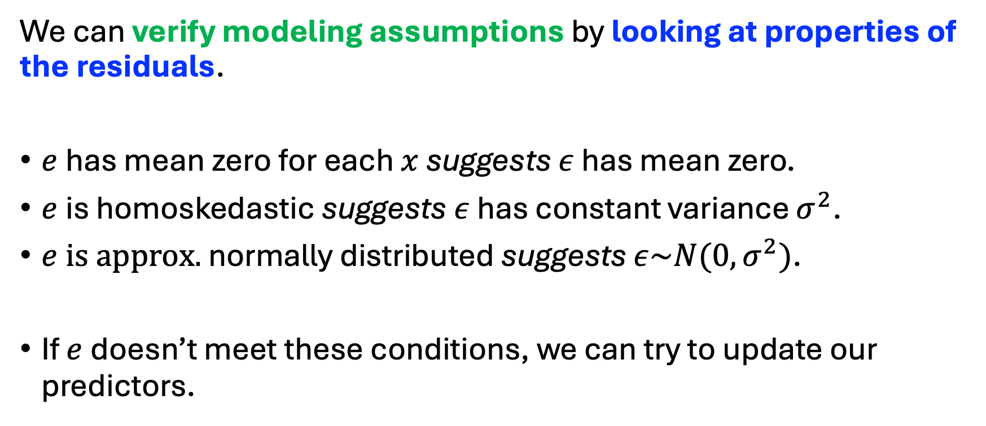
Checking Residuals Against our “Big 3”
We can verify modeling assumptions by looking at properties of the residuals.
$e$has mean zero for each $x$ suggests $ε$ has mean zero.
$e$is homoskedastic suggests $ε$ has constant variance $σ^{2}$.
$e is approx.$ normally distributed suggests $ε\sim N(0,σ^{2})$.
If $e$doesn’t meet these conditions, we can try to update our predictors.

Slide 6
Plot Types
For this first part, we will look at what types of plots (tools) we use to evaluate our model.
Later, we will look at how these plots are generated in R and Python.

Slide 7
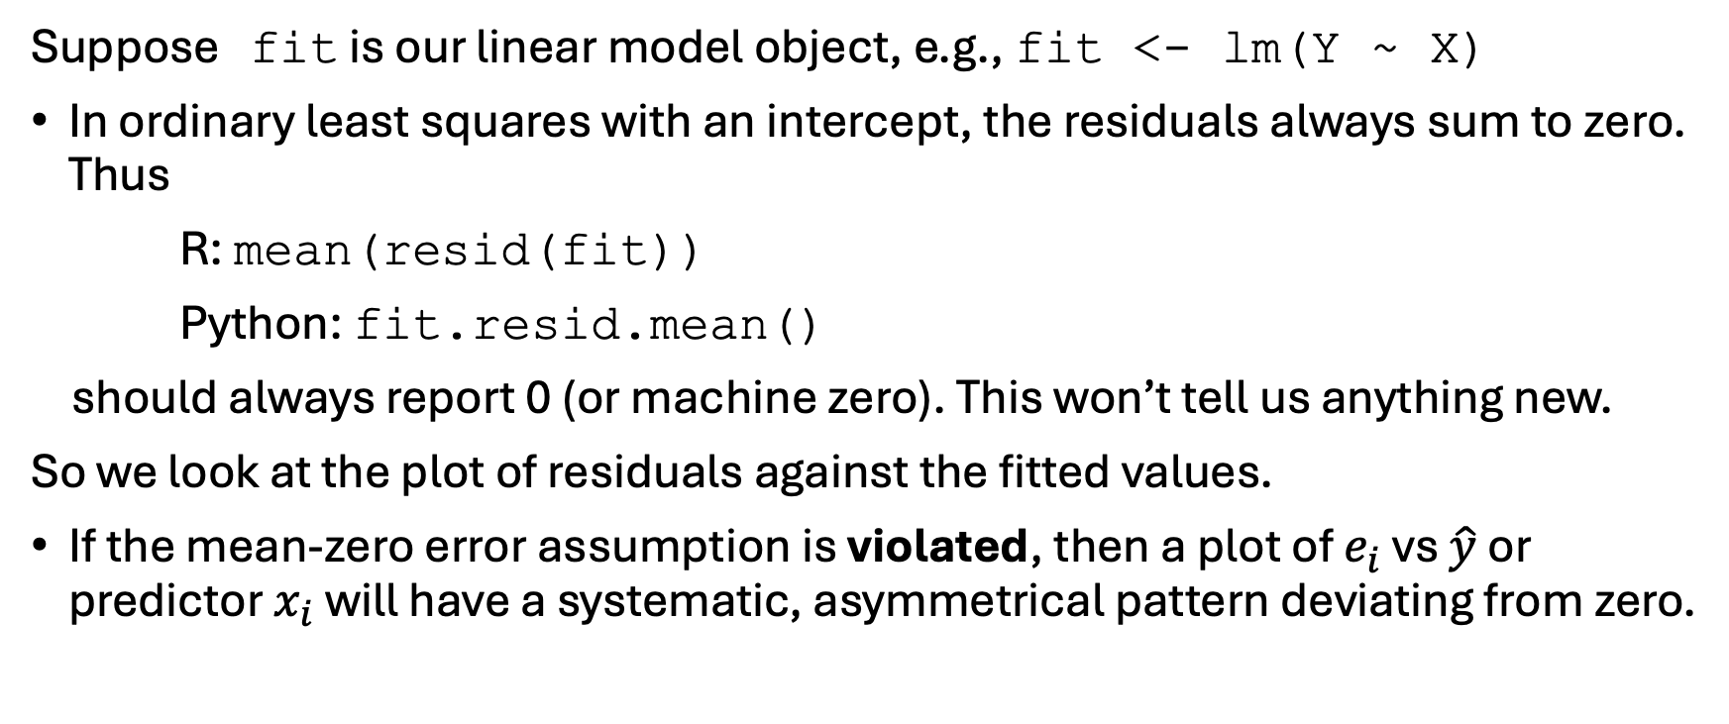
Residual Diagnostic: Checking Mean Zero Assumption
Suppose fit is our linear model object, e.g., fit <- lm(Y ~ X)
In ordinary least squares with an intercept, the residuals always sum to zero. Thus
R: mean(resid(fit))
Python: fit.resid.mean()
should always report 0 (or machine zero). This won’t tell us anything new.
So we look at the plot of residuals against the fitted values.
If the mean-zero error assumption is violated, then a plot of $e_{i}$ vs $\hat{y}$ or predictor $x_{i}$ will have a systematic, asymmetrical pattern deviating from zero.

Slide 8
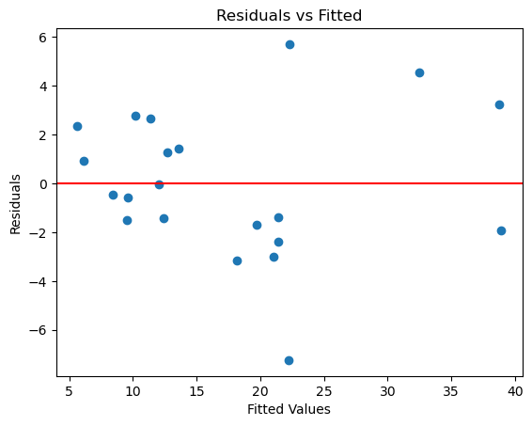

Residuals vs. Fitted: $e_{i}$ vs $\hat{y}$
What it reveals:
Nonlinearity
Heteroskedasticity
Outliers
Patterns that indicate missing interactions or transformations
What we want to see:
A shapeless cloud
Little-to-no curvature
Little-to-no funneling

Slide 9
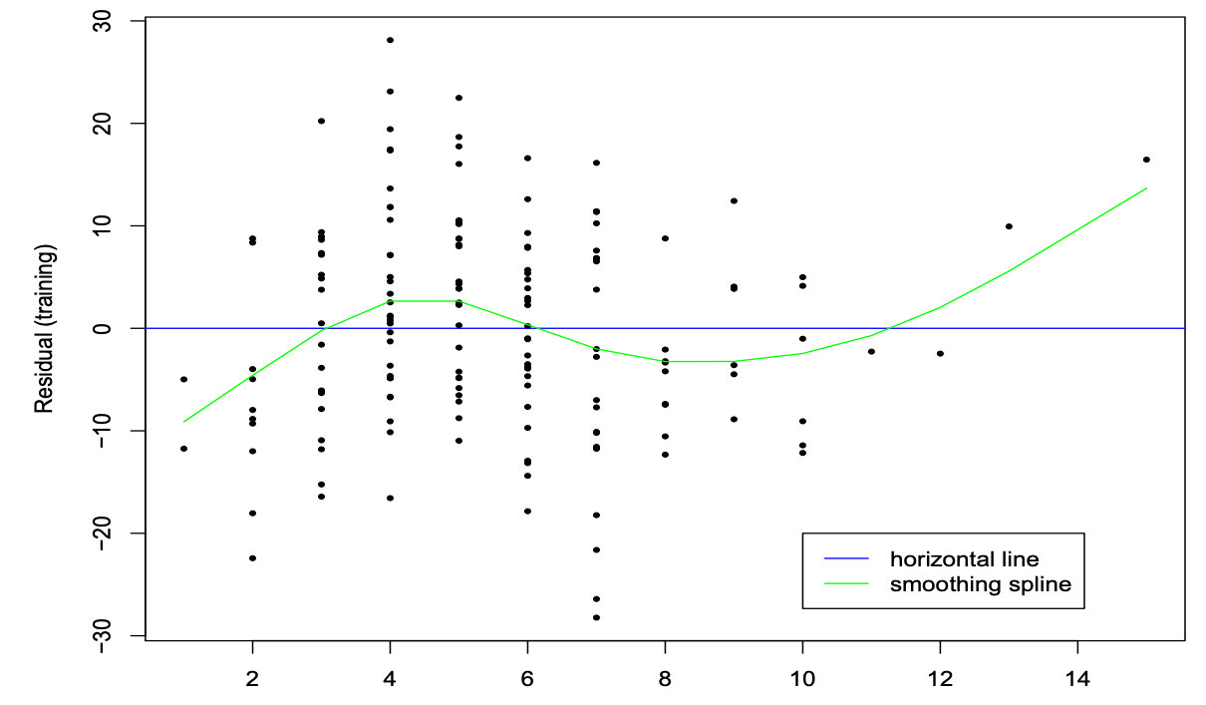

Residuals vs. Predictor(s): $e_{i}$ vs $x_{i}$
Plotting against each predictor:
Helps identify which predictor is causing curvature
Helps diagnose variance patterns tied to specific predictors
Helps guide transformations (log, sqrt, power, etc.)
This is where we connect diagnostics to actionable modeling decisions.

Slide 10
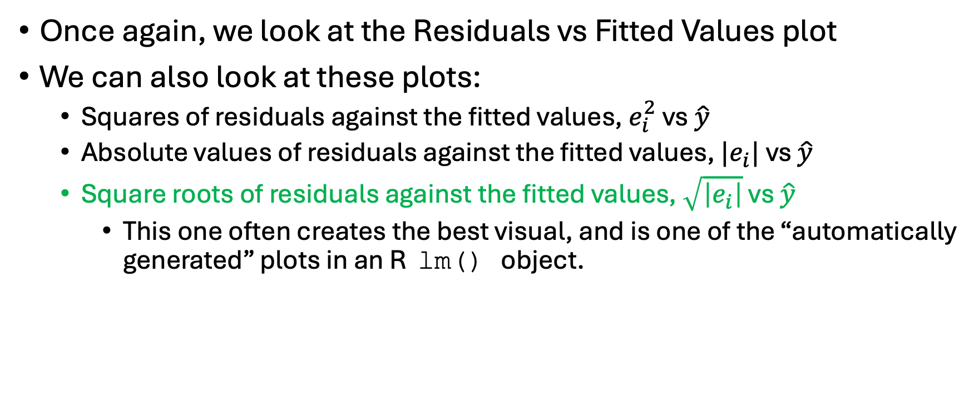
Checking the Constant Variance Assumption
Once again, we look at the Residuals vs Fitted Values plot
We can also look at these plots:
Squares of residuals against the fitted values, $e_{i}^{2}$vs $\hat{y}$
Absolute values of residuals against the fitted values, $|e_{i}|$ vs $\hat{y}$
Square roots of residuals against the fitted values, $\sqrt{\left|e_{i}\right|}$ vs $\hat{y}$
This one often creates the best visual, and is one of the “automatically generated” plots in an R lm() object.

Slide 11
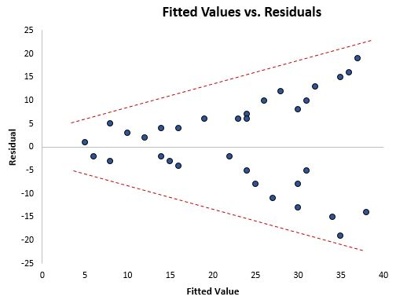
Heteroskedasticity
Variance increasing with fitted values
(Previous HW problem used simulation to show this)
Image source: https://www.statology.org/breusch-pagan-test/

Slide 12
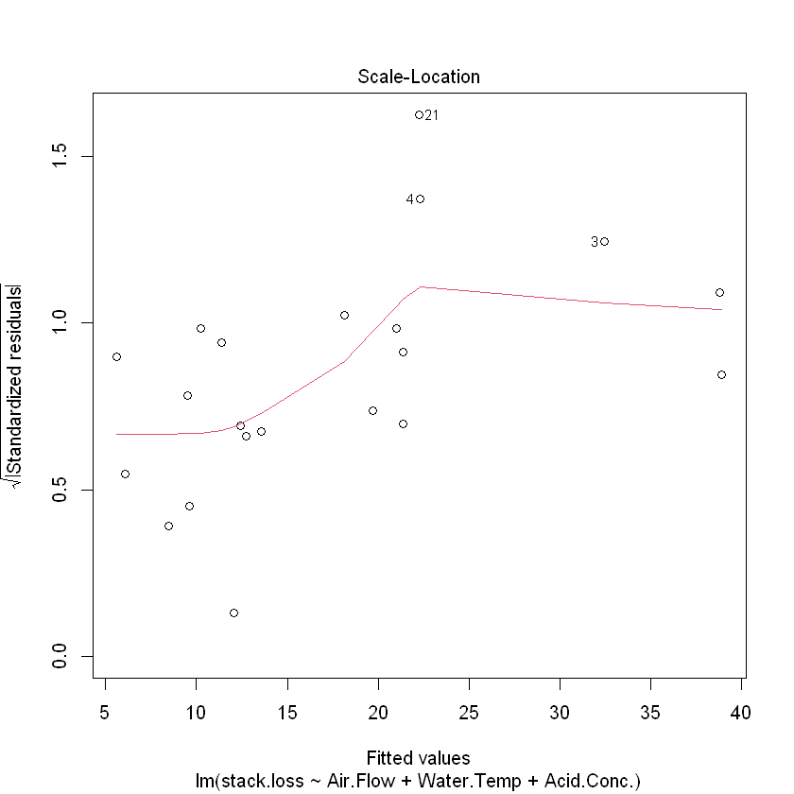

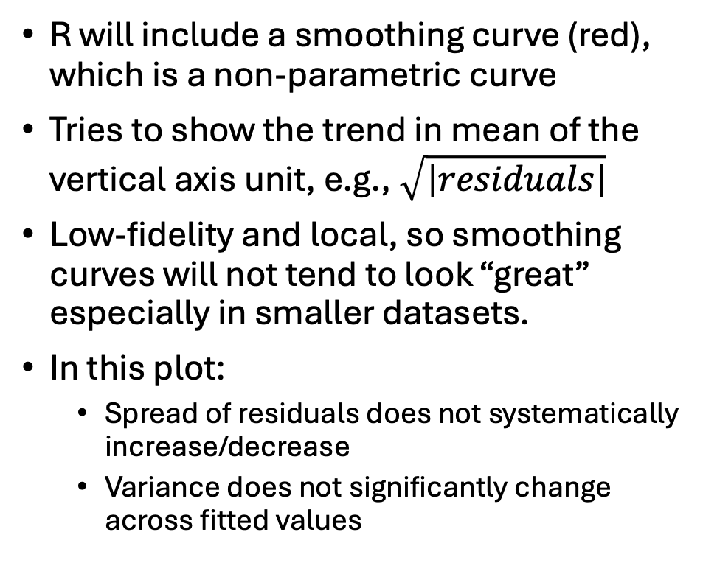
Scale-Location, $\sqrt{\left|e_{i}\right|}$ vs $\hat{y}$
R will include a smoothing curve (red), which is a non-parametric curve
Tries to show the trend in mean of the vertical axis unit, e.g., $\sqrt{\left|residuals\right|}$
Low-fidelity and local, so smoothing curves will not tend to look “great” especially in smaller datasets.
In this plot:
Spread of residuals does not systematically increase/decrease
Variance does not significantly change across fitted values

Slide 13
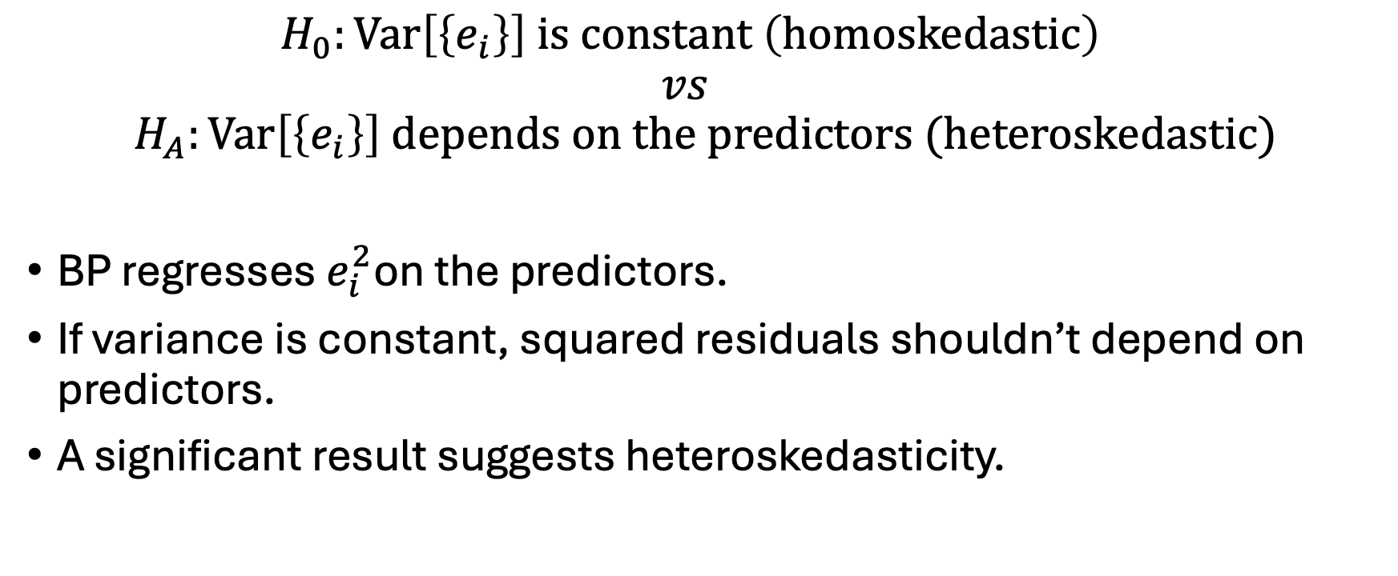
The Breusch–Pagan (BP) Test
$$H_{0}:Var\left[\left\{e_{i}\right\}\right] is constant \left(homoskedastic\right)$$
$$vs$$
$$H_{A}:Var\left[\left\{e_{i}\right\}\right] depends on the predictors (heteroskedastic)$$
BP regresses $e_{i}^{2}$on the predictors.
If variance is constant, squared residuals shouldn’t depend on predictors.
A significant result suggests heteroskedasticity.

Slide 14
The Breusch–Pagan (BP) Test
R:
library(lmtest)
bptest(fit)
Python:
from statsmodels.stats.diagnostic import het_breuschpagan
# Breusch–Pagan test
bp_test = het_breuschpagan(fit.resid, fit.model.exog)
bp_test
R:
studentized Breusch-Pagan testdata: fit
BP = 4.8904, df = 3, p-value = 0.18
Python:
(np.float64(4.890367743975322), np.float64(0.18000324351490046), np.float64(1.7202182794807785), np.float64(0.200707041993429))
Additional, F-statistic formulation of the BP test.

Slide 15
BP Bottom Line
Limitations
BP is sensitive to model misspecification (i.e., not the best model for our data).
BP can flag heteroskedasticity even when the model is simply nonlinear.
BP can miss heteroskedasticity if the variance pattern is subtle.
Don’t use the BP test in a vacuum
Use the plots as our primary tool to check for constant variance
BP test doesn’t tell us how to fix the problem.
If the plot looks heteroskedastic, it is. If the plot looks fine, but BP says otherwise, trust the plot.

Slide 16
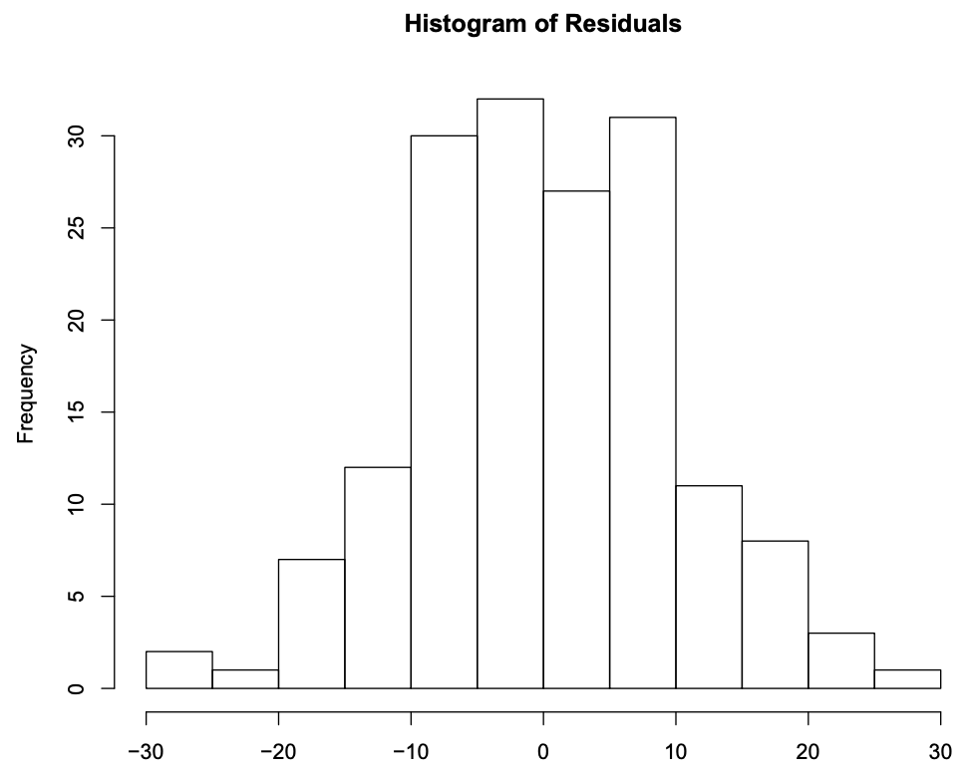
Residual Diagnostic Tools: Checking Normality
We can assess the normality assumption using:
A histogram of residuals
A Quantile-Quantile (Q-Q) plot
There are hypothesis test-based tools (e.g., Shapiro-Wilk, Kolmogorov-Smirnov) but tend to be too sensitive to be useful.
BL: Stick to the plots

Slide 17
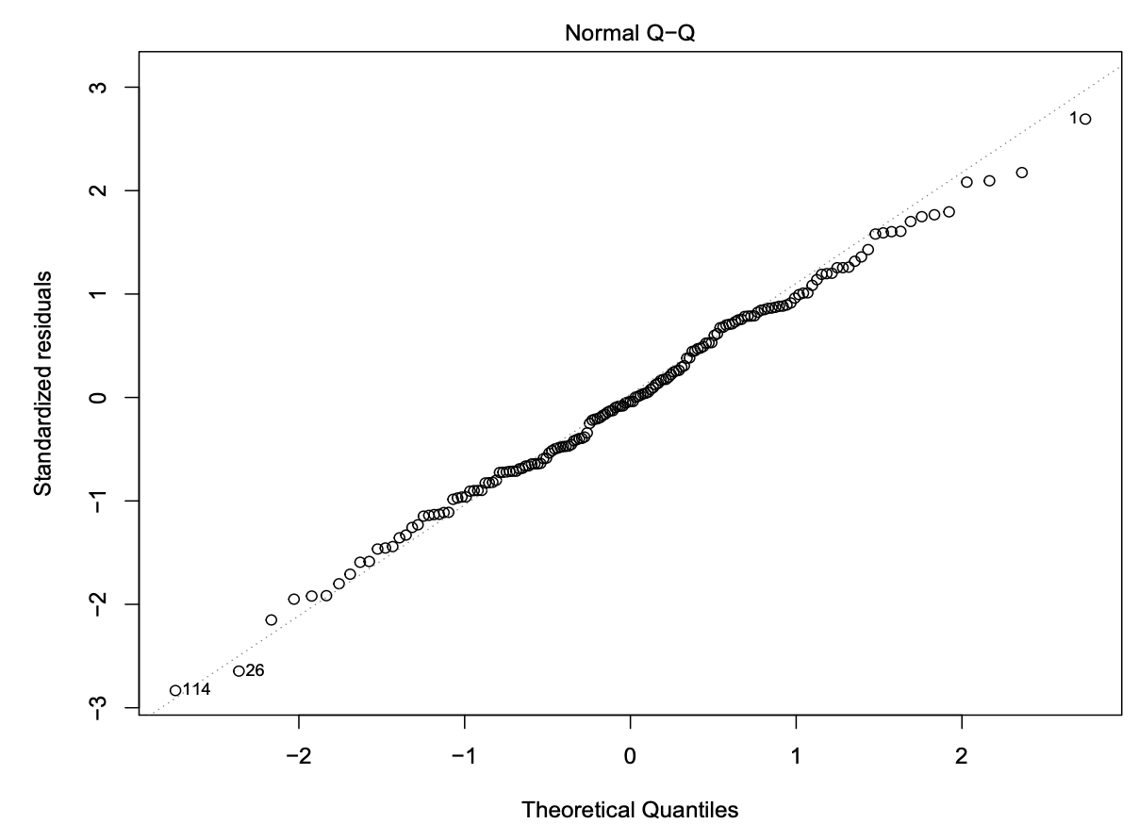
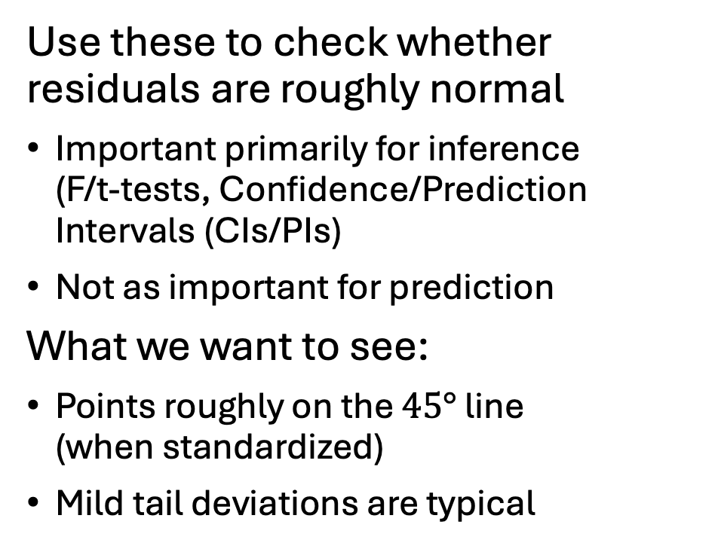
Normal Quantile–Quantile (Q-Q) Plot
Use these to check whether residuals are roughly normal
Important primarily for inference (F/t‑tests, Confidence/Prediction Intervals (CIs/PIs)
Not as important for prediction
What we want to see:
Points roughly on the $45°$ line (when standardized)
Mild tail deviations are typical

Slide 18
Residual Diagnostic Tools – Hands On
Try the following in R:
fit <- lm(stack.loss ~ Air.Flow + Water.Temp + Acid.Conc., data=stackloss)
plot(fit)
What do we get from this?

Slide 19
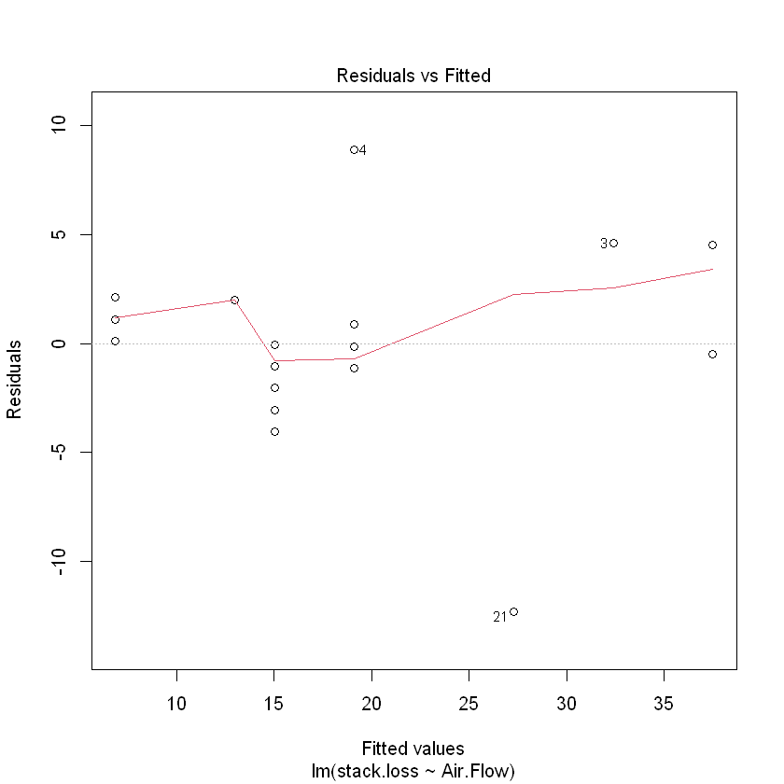
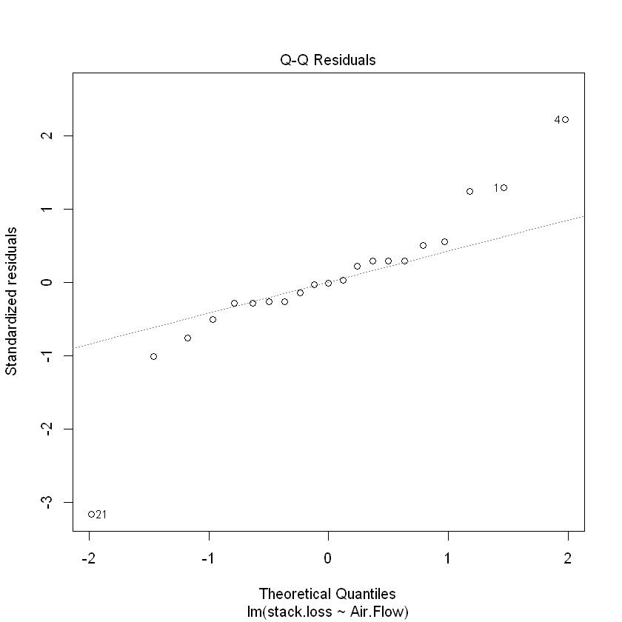
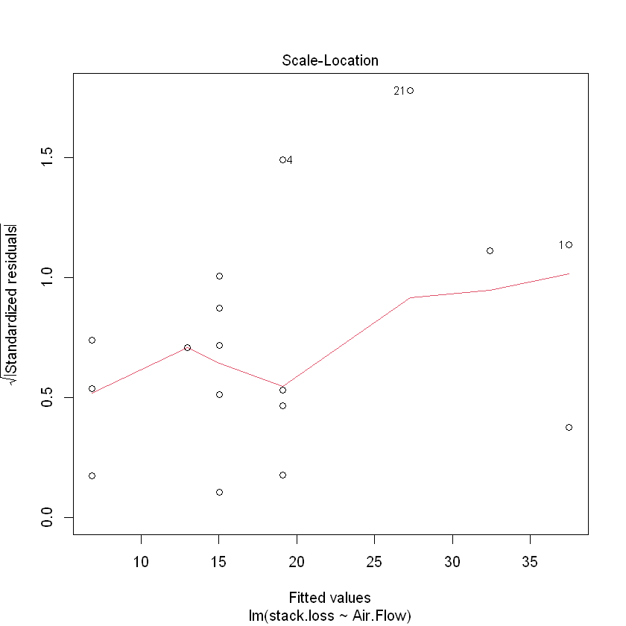
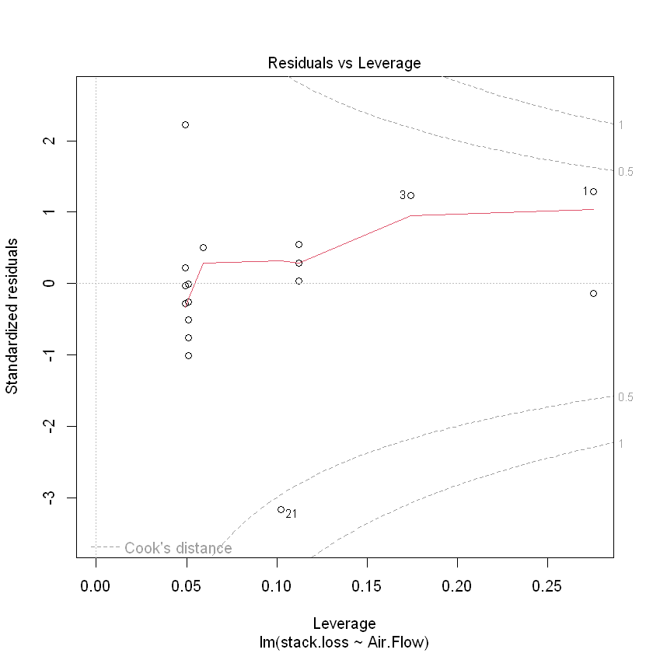
Four Plots

Slide 20
Residual Diagnostic Tools – Hands On
R: Selecting them individually
plot(fit, which = 1) # Residuals vs Fitted
plot(fit, which = 2) # Normal Q-Q of Residuals
plot(fit, which = 3) # Scale-Location
plot(fit, which = 5) # Residuals vs Leverage

Slide 21
Residual Diagnostic Tools – Hands On
Python equivalents:
import statsmodels.api as sm
import matplotlib.pyplot as plt
stackloss = sm.datasets.stackloss.load_pandas().data
fit = sm.OLS(stackloss['STACKLOSS'], sm.add_constant (stackloss.drop('STACKLOSS', axis=1))).fit()
# Extract residuals and fitted values
resid = fit.resid
fitted = fit.fittedvalues

Slide 22
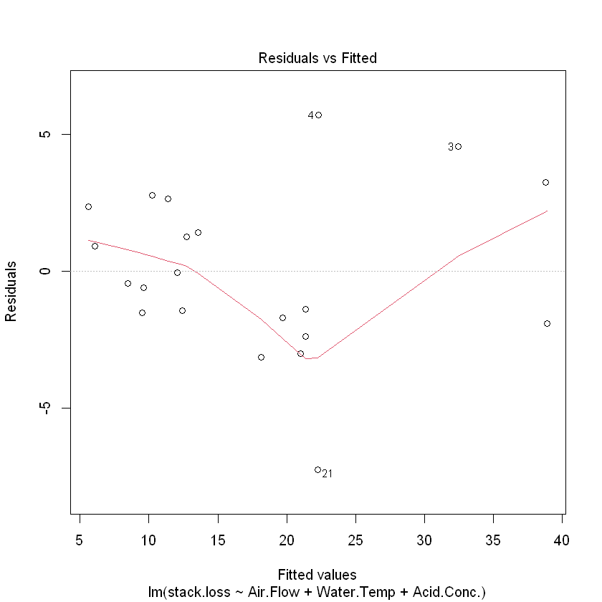
Residuals vs Fitted
plot(fit, which = 1)

Slide 23
Residual Diagnostic Tools
Python equivalents (Residuals vs Fitted)
plt.scatter(fitted, resid)
plt.axhline(0, color='red’)
plt.xlabel("Fitted Values")
plt.ylabel("Residuals")
plt.title("Residuals vs Fitted")
plt.show()

Slide 24
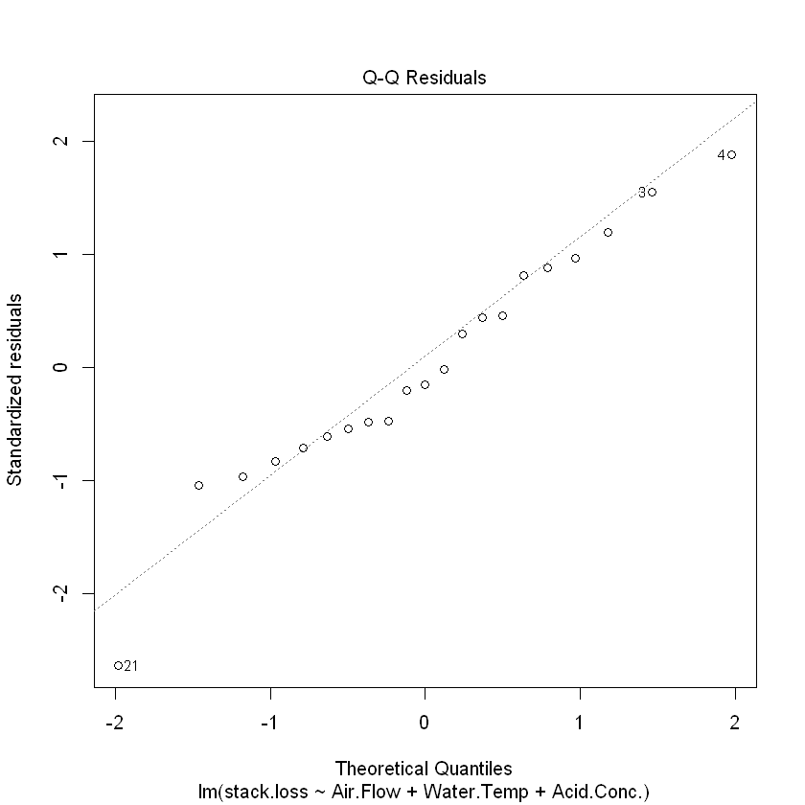
Residual Q-Q Plot
plot(fit, which = 2)

Slide 25
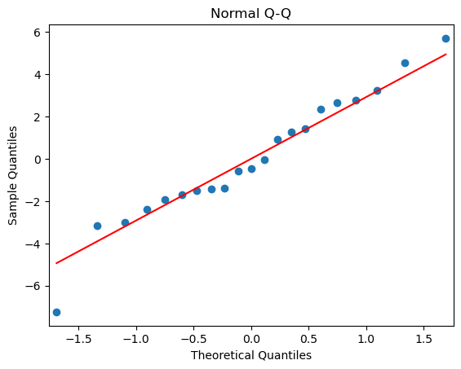
Residual Diagnostic Tools – Hands On
Python equivalents (Normal QQ-plot)
sm.qqplot(resid, line=‘s’)
plt.title("Normal Q-Q")
plt.show()
Differs slightly from R plot
R uses standardized residuals and a slightly different algorithm
The salient analysis is still worthwhile

Slide 26
Scale-Location Plot
plot(fit, which = 3)

Slide 27
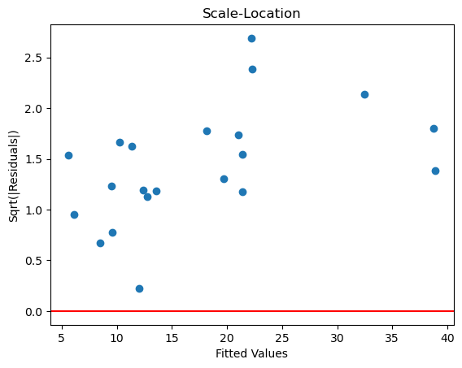
Residual Diagnostic Tools – Hands On
Python equivalents (Scale-Location Plot)
import numpy as np
plt.scatter(fitted, np.sqrt (np.abs(resid)))
plt.axhline(0, color='red’)
plt.xlabel("Fitted Values")
plt.ylabel("Sqrt(|Residuals|)")
plt.title("Scale-Location")
plt.show()

Slide 28
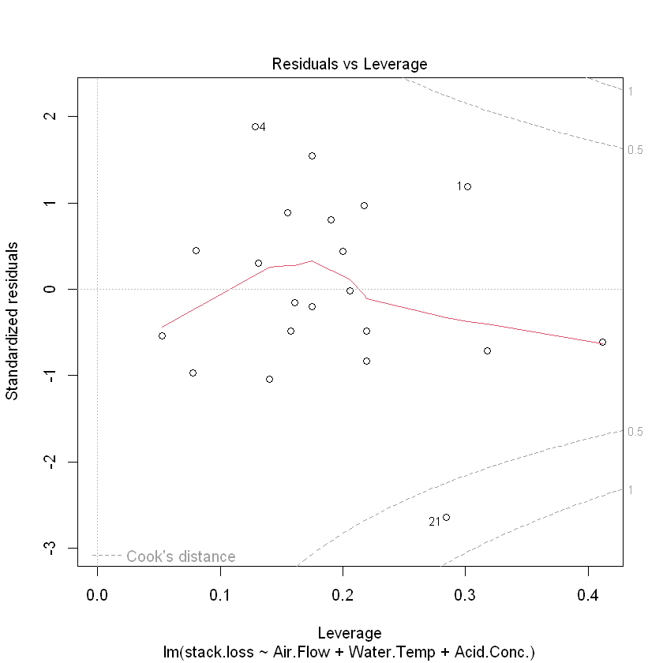
Residuals vs Leverage (Cook’s Distance)
plot(fit, which = 5)

Slide 29
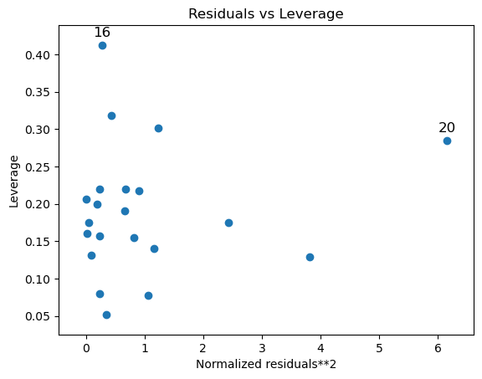
Residual Diagnostic Tools – Hands On
Python equivalents (Residuals vs Leverage)
from statsmodels.graphics.regressionplots import influence_plot
influence_plot(fit)
plt.title("Residuals vs Leverage")
plt.show()

Slide 30
Closer to R
# Studentized Residuals vs Leverage plot with Cook's distance contours (Closer to R's plot)
influence = fit.get_influence()
# Extract leverage and studentized residuals
leverage = influence.hat_matrix_diag
stud_resid = influence.resid_studentized_internal
plt.scatter(leverage, stud_resid, alpha=0.7)
plt.xlabel("Leverage")
plt.ylabel("Studentized Residuals")
plt.title("Leverage vs Studentized Residuals with Cook's Distance Contours")
# Cook's distance contours
p = fit.df_model + 1 # number of parameters including intercept
h_vals = np.linspace(0.001, max(leverage) * 1.1, 200)
for D in [0.5, 1]: # typical contour levels
r_vals = np.sqrt(D * p * (1 - h_vals)**2 / h_vals)
plt.plot(h_vals, r_vals, 'r--', linewidth=1)
plt.plot(h_vals, -r_vals, 'r--', linewidth=1)
plt.text(h_vals[-1], r_vals[-1], f"D={D}", color='red')
# Set the vertical axis limits to integers above the max and below the min studentized residuals
plt.ylim(int(min(stud_resid)) - 1, int(max(stud_resid)) + 1)
plt.show()

Slide 31
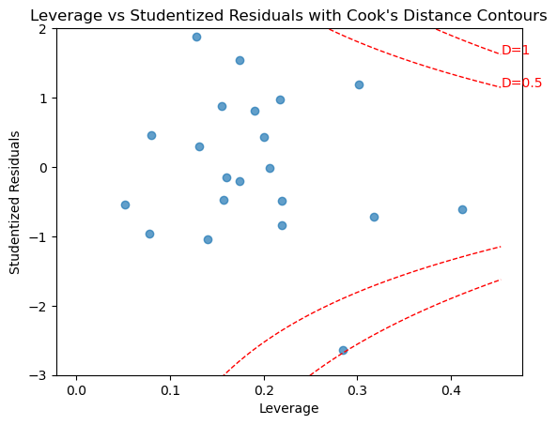
(Studentized) Residuals vs Leverage
Python Version

Slide 32
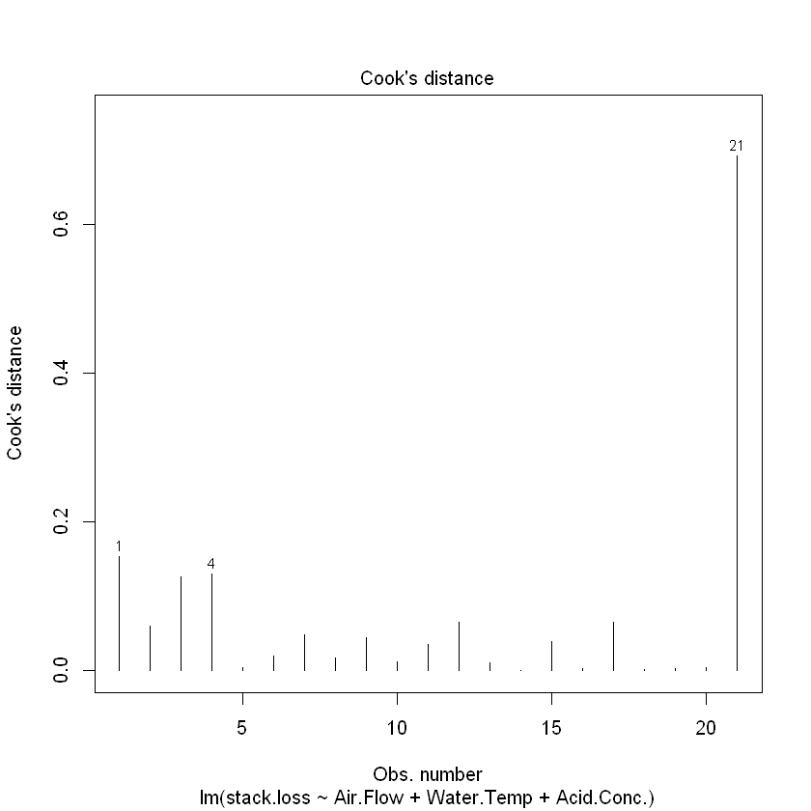
What about R’s Plot #4?
plot(fit, which = 4)
Not used as often because it’s combined in Plot #5.

Slide 33
Python Woes
R was built as a statistical analysis software package
Python is an object oriented programming language
While powerful, needs packages and boilerplate code to get things done
It is possible to write a function in Python to replicate the R plots, and to output either
All four at once, or
Calling each one specifically.

Slide 34
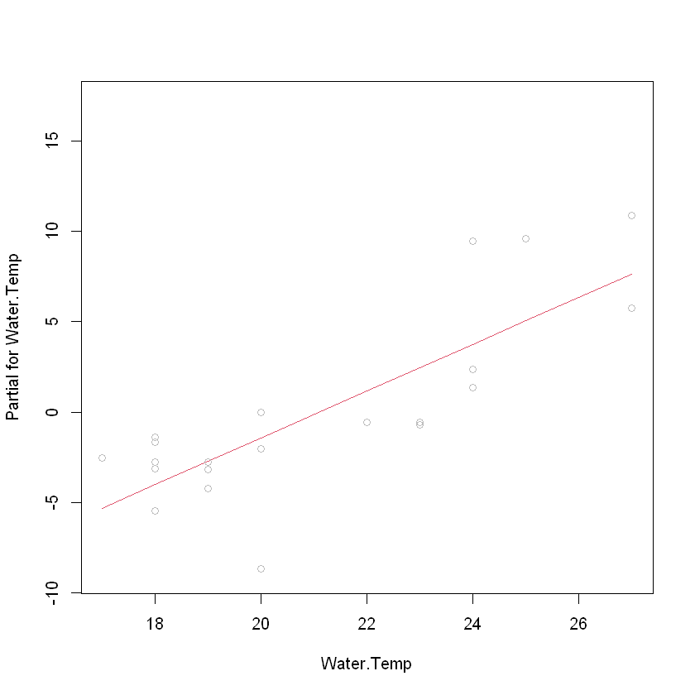
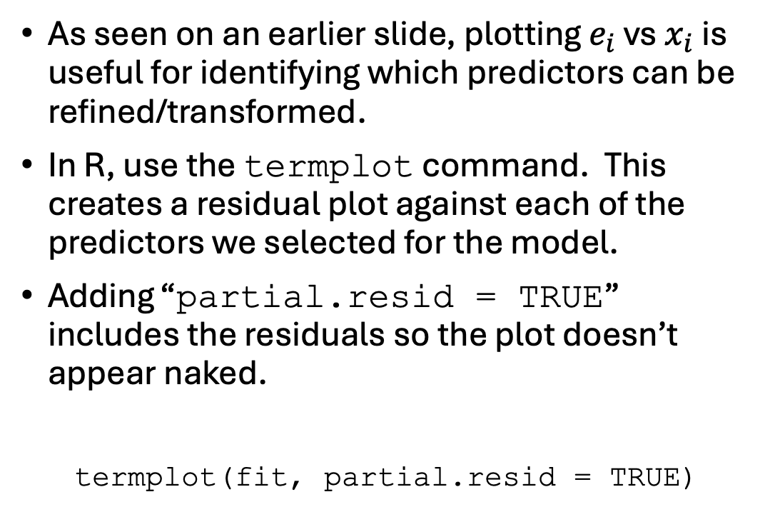
Checking Residuals against Predictors
As seen on an earlier slide, plotting $e_{i}$ vs $x_{i}$ is useful for identifying which predictors can be refined/transformed.
In R, use the termplot command. This creates a residual plot against each of the predictors we selected for the model.
Adding “partial.resid = TRUE” includes the residuals so the plot doesn’t appear naked.
termplot(fit, partial.resid = TRUE)

Slide 35
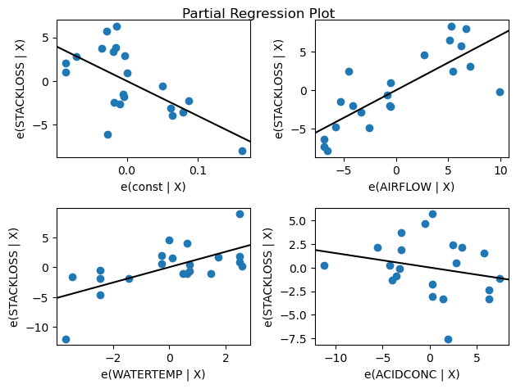
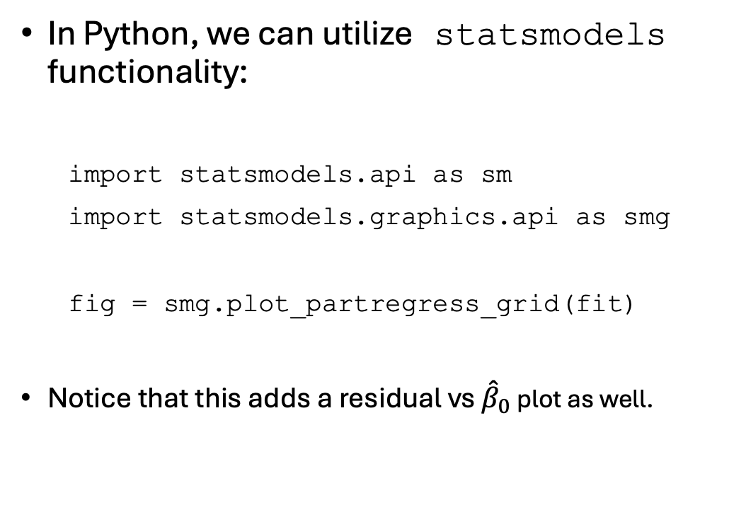
Checking Residuals against Predictors
In Python, we can utilize statsmodels functionality:
import statsmodels.api as sm
import statsmodels.graphics.api as smg
fig = smg.plot_partregress_grid(fit)
Notice that this adds a residual vs ${\hat{β}}_{0}$ plot as well.

Slide 36

While We’re Here…
Let’s Close the Loop on lm() / .OLS Output
Adjusted $R^{2}$
Other tests: Omnibus, Durbin-Watson etc.
t-tests for individual coefficients ${\hat{β}}_{j}$

Slide 37
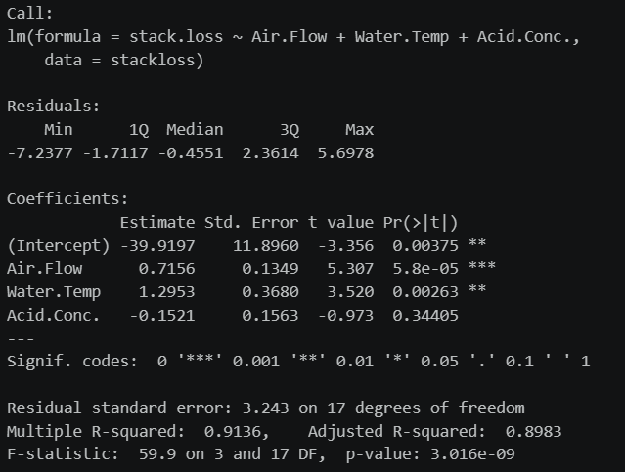
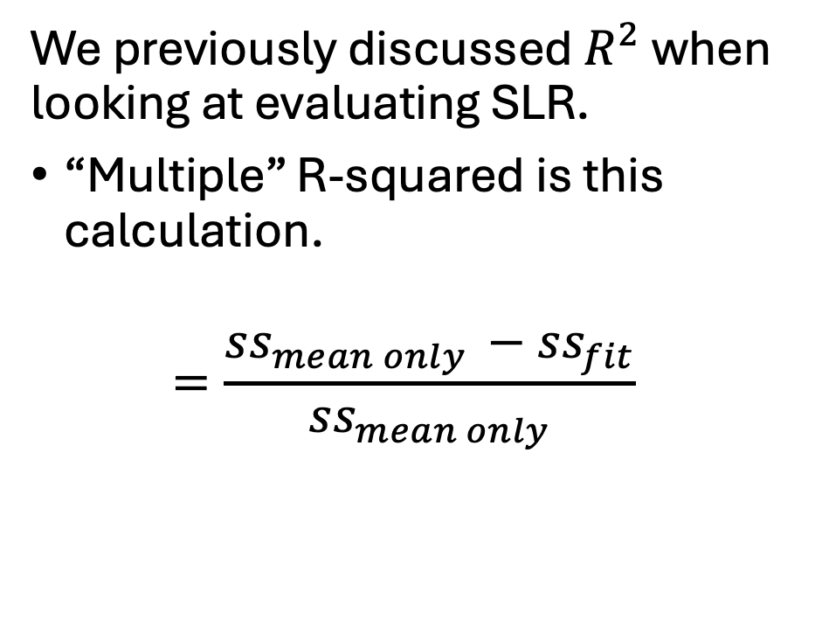
R’s lm() Summary- Multiple R-Squared
We previously discussed $R^{2}$ when looking at evaluating SLR.
“Multiple” R-squared is this calculation.
$$=\frac{ss_{mean only }−ss_{fit}}{ss_{mean only}}$$

Slide 38
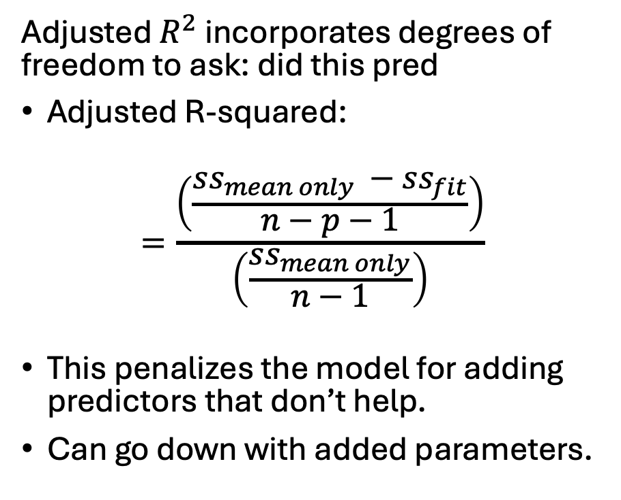
R’s lm() Summary – Adjusted R-Squared
Adjusted $R^{2}$ incorporates degrees of freedom to ask: did this pred
Adjusted R-squared:
$$=\frac{\left(\frac{ss_{mean only }−ss_{fit}}{n−p−1}\right)}{\left(\frac{ss_{mean only}}{n−1}\right)}$$
This penalizes the model for adding predictors that don’t help.
Can go down with added parameters.
Notes:
Adjusted R² asks: did this predictor improve the model enough to justify the extra complexity? It’s a ‘return on investment’ metric. If adjusted R² goes down, the predictor didn’t earn its keep.

Slide 39
R’s lm() Summary – F-tests
Recall the F-test, which asks whether our model as a whole fits the data with statistical significance.
In SLR, the F-test and t-test for the single predictor were the same
In MLR, the F-test asks whether any predictors have signal; the t-tests ask which ones do.
Notes:
Adjusted R² asks: did this predictor improve the model enough to justify the extra complexity? It’s a ‘return on investment’ metric. If adjusted R² goes down, the predictor didn’t earn its keep.

Slide 40
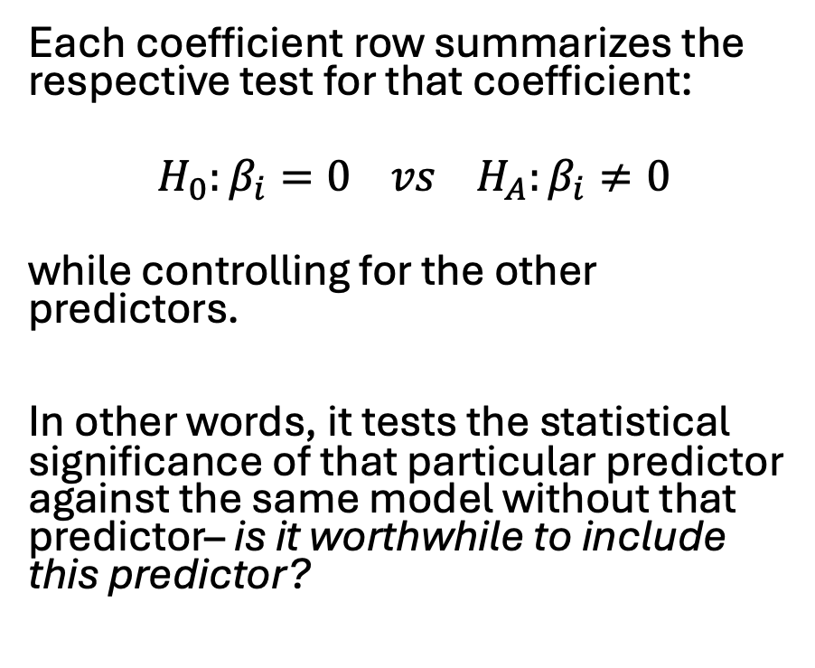
R’s lm() Summary – t-tests
Each coefficient row summarizes the respective test for that coefficient:
$$H_{0}:β_{i}=0 vs H_{A}:β_{i}≠0$$
while controlling for the other predictors.
In other words, it tests the statistical significance of that particular predictor against the same model without that predictor– is it worthwhile to include this predictor?
Notes:
Adjusted R² asks: did this predictor improve the model enough to justify the extra complexity? It’s a ‘return on investment’ metric. If adjusted R² goes down, the predictor didn’t earn its keep.

Slide 41
R’s lm() Summary – t-tests
For example, both Air Flow and Water Temp have low p-values, suggesting that their respective additions are significant in reducing the MSE for the model.
Ex: The p-value for having all three predictors indicates that it is worth adding Water Temp as a predictor, vs. only having Air Flow and Acid Concentration.
Notes:
Adjusted R² asks: did this predictor improve the model enough to justify the extra complexity? It’s a ‘return on investment’ metric. If adjusted R² goes down, the predictor didn’t earn its keep.

Slide 42
R’s lm() Summary – t-tests
Example:
The associated p-value for Acid Concentration, on the other hand, would cause us to fail to reject the null hypothesis.
This suggests that Acid Concentration does not add detectable linear signal when already considering Air Flow and Water Temp.
Notes:
Adjusted R² asks: did this predictor improve the model enough to justify the extra complexity? It’s a ‘return on investment’ metric. If adjusted R² goes down, the predictor didn’t earn its keep.

Slide 43
R’s lm() Summary – t-tests
You’ll notice that R provides a significance code for certain p-value categories, such as
** for .01.
A key for these symbols is displayed below the coefficient breakdown.
Notes:
Adjusted R² asks: did this predictor improve the model enough to justify the extra complexity? It’s a ‘return on investment’ metric. If adjusted R² goes down, the predictor didn’t earn its keep.

Slide 44
R’s lm() Summary – Std. Error
We will discuss the math behind the t-tests as well as standard error in a later lecture when we look at confidence and prediction intervals.
Notes:
Adjusted R² asks: did this predictor improve the model enough to justify the extra complexity? It’s a ‘return on investment’ metric. If adjusted R² goes down, the predictor didn’t earn its keep.

Slide 45
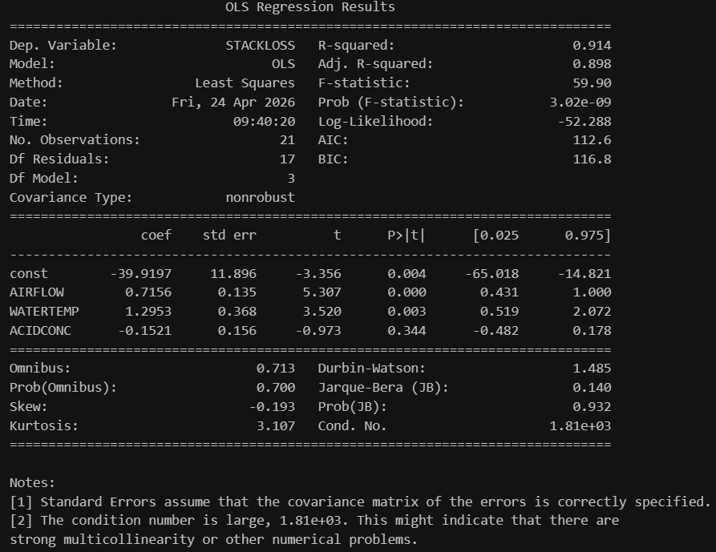
Python + statsmodels Summary Output
Python’s statsmodels OLS output was designed to mirror R with a plethora of additional summary output.
Adjusted R-squared, F- and t-tests are the same as we saw in R.

Slide 46
Python + statsmodels Summary Output
The statsmodels package includes confidence intervals for each of the coefficients. These are the same as computed by R (just not displayed).
Again, we will discuss these in a specific lecture.

Slide 47
Python + statsmodels Summary Output
We will cover the summary output that is distinct from R, starting from the top.
Log-Likelihood, Akaike Information Criterion (AIC), and Bayesian Information Criterion (BIC are related. They are ways of quantifying the fit of our model with respect to the number of parameters. We will cover these in more detail in a later lecture.

Slide 48
Python + statsmodels Summary Output
The next few tests we will not cover in depth during this class (read: we will not go into the underlying math or formulae).
We will discuss what they are for completeness, but we will not be expected to reference them in HW, projects, or exams.

Slide 49
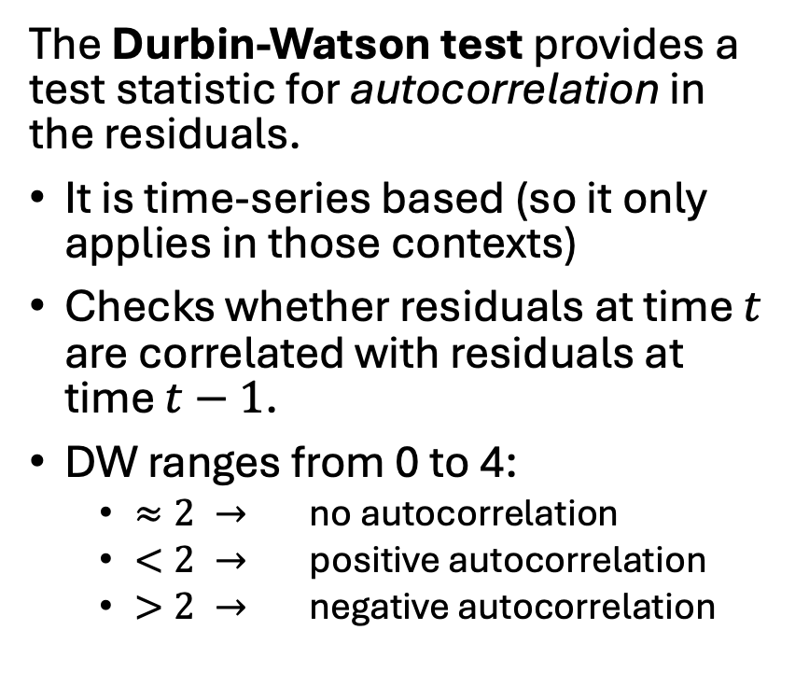
Python + statsmodels Summary Output
The Durbin-Watson test provides a test statistic for autocorrelation in the residuals.
It is time-series based (so it only applies in those contexts)
Checks whether residuals at time $t$ are correlated with residuals at time $t−1$.
DW ranges from 0 to 4:
$≈2 →$ no autocorrelation
$<2 →$ positive autocorrelation
$>2 →$ negative autocorrelation

Slide 50
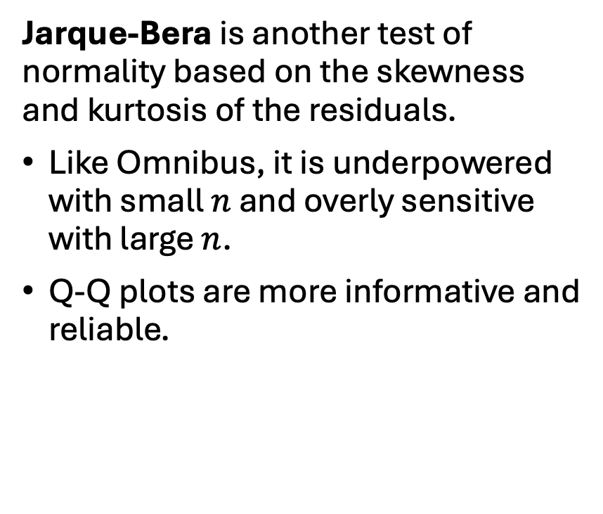
Python + statsmodels Summary Output
Jarque-Bera is another test of normality based on the skewness and kurtosis of the residuals.
Like Omnibus, it is underpowered with small $n$ and overly sensitive with large $n$.
Q-Q plots are more informative and reliable.

Slide 51
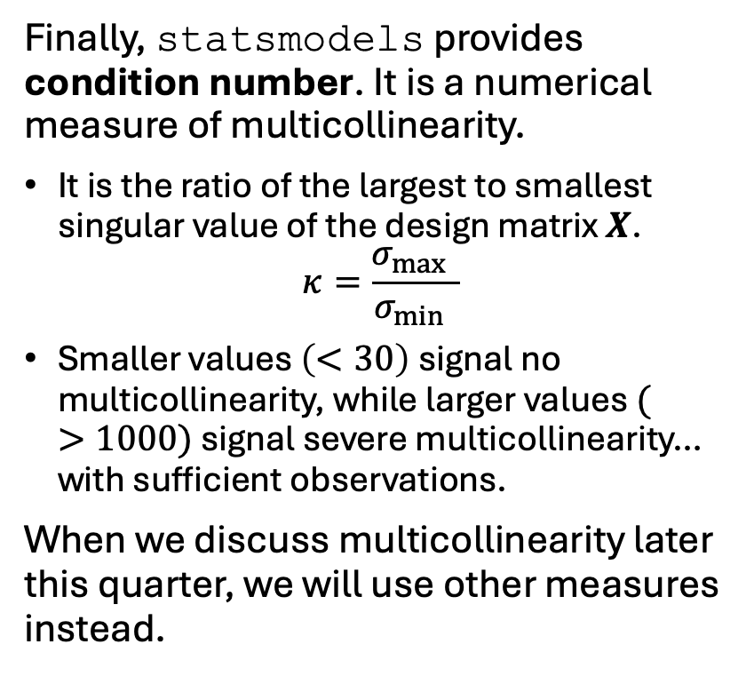
Python + statsmodels Summary Output
Finally, statsmodels provides condition number. It is a numerical measure of multicollinearity.
It is the ratio of the largest to smallest singular value of the design matrix $X$.
$$κ=\frac{σ_{\max{ }}}{σ_{\min{ }}}$$
Smaller values $\left(<30\right)$signal no multicollinearity, while larger values $(>1000)$ signal severe multicollinearity… with sufficient observations.
When we discuss multicollinearity later this quarter, we will use other measures instead.

Slide 52
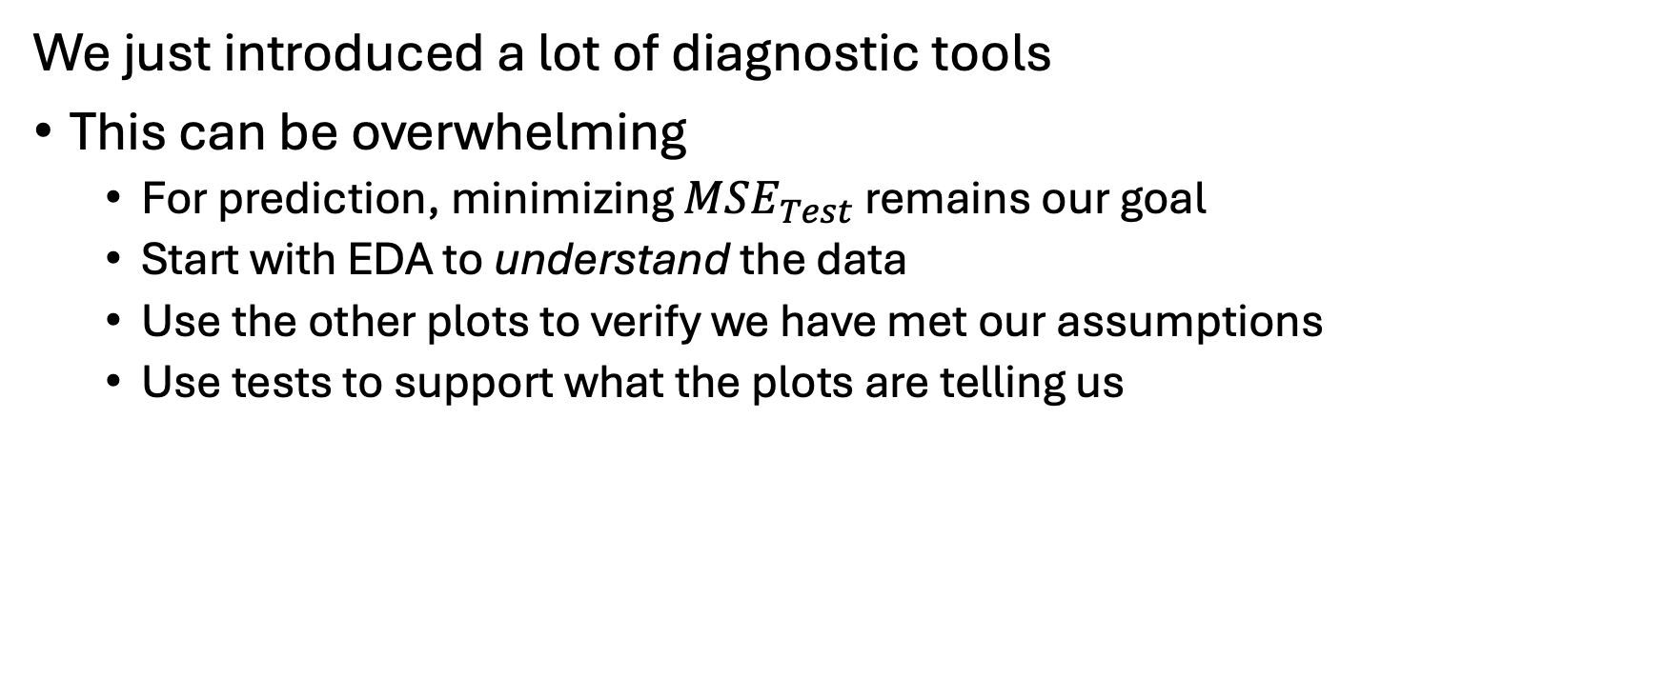
Which tests or plots should we use?
We just introduced a lot of diagnostic tools
This can be overwhelming
For prediction, minimizing $MSE_{Test}$ remains our goal
Start with EDA to understand the data
Use the other plots to verify we have met our assumptions
Use tests to support what the plots are telling us

Slide 53
A hierarchy of model evaluation
As a technique:
Test MSE — primary metric for prediction
Residual plots — primary tool for diagnosing structure
Partial regression plots — check linearity of each predictor
BP test— supporting evidence
t‑tests and F‑tests — inference
Use your intuition!

